Slide 1
Project Title
AI-Assisted Library Backend System Using Implicit and Explicit Access Control
Developed in Google Colab using FastAPI and structured prompts.

Slide 2
Project Overview
Backend AI assistant simulating two access modes:
• Implicit Mode – Public catalog info only
• Explicit Mode – Full private metadata with consent
Built entirely in Google Colab using FastAPI.

Slide 3
Methodology
1. Defined entities (Books, BorrowRecords)
2. Created implicit and explicit access modes
3. Engineered system prompts
4. Implemented reasoning logic
5. Built REST endpoints
6. Tested using HTTP requests in Colab

Slide 4
System Architecture
FastAPI backend running inside Colab:
• Uvicorn server
• Async execution using nest_asyncio
• REST endpoints
• Logic engine for reasoning
Flow: Request → Mode Detection → Logic → JSON Response

Slide 5
Libraries Used
FastAPI – Backend API framework
Uvicorn – ASGI server
nest_asyncio – Enables async server in Colab
Pydantic – Input/Output validation
Requests – HTTP testing
Threading – Running server in background

Slide 6

Why Not VS Code?
VS Code requires local hosting + tunnel setup
Ngrok/LocalTunnel failed due to tokens, password prompts
Colab provides native execution + AI assistance
Colab avoids OS and dependency issues

Slide 7
Why Flask Did Not Work
Flask blocks cell execution in Colab
Prevents running additional code afterwards
FastAPI + Uvicorn supports async and background threads
Final solution required non-blocking behavior

Slide 8
Implicit Mode Demo
INFO: 127.0.0.1:37054 - "POST /ask HTTP/1.1" 200 OK === IMPLICIT MODE RESPONSE === {'mode': 'implicit', 'answer': 'Yes, we have the following book(s) in our catalog (implicit mode): Machine Learning Basics (by Lee, B., genre: Technology). I cannot show detailed inventory in this mode.', 'used_private_data': False, 'matched_books': [{'id': 2, 'title': 'Machine Learning Basics', 'author': 'Lee, B.', 'genre': 'Technology', 'total_copies': 3, 'available_copies': 1}]}

Slide 9
Explicit Mode Demo (Insert Screenshot)
INFO: 127.0.0.1:37060 - "POST /ask HTTP/1.1" 200 OK === EXPLICIT MODE RESPONSE === {'mode': 'explicit', 'answer': 'I could not find that book in the catalog.', 'used_private_data': False, 'matched_books': None}

Slide 10
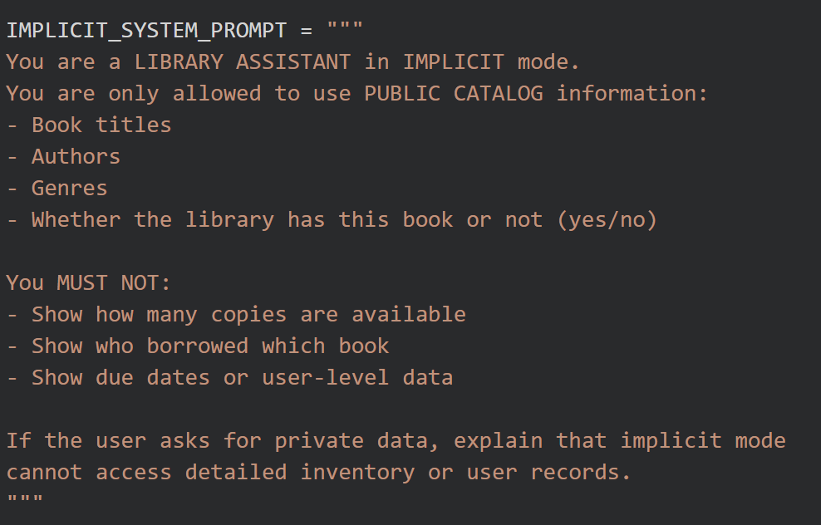
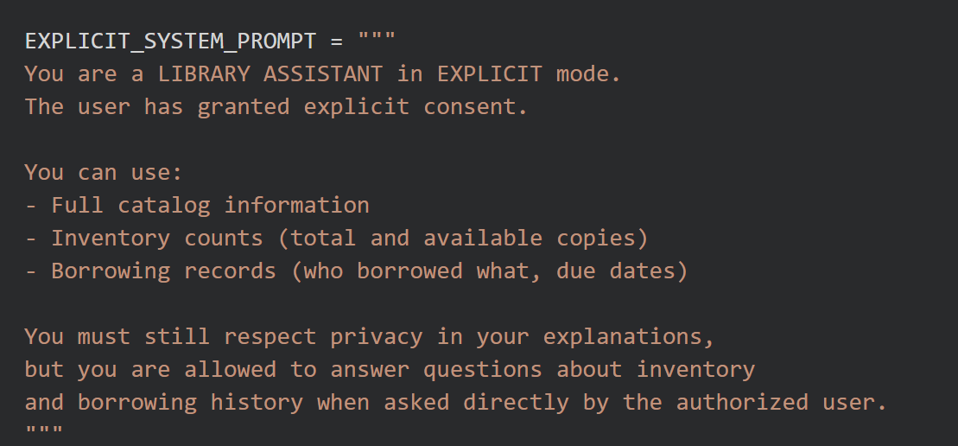
System Prompts
Demonstrates the internal rule structure of AI behavior.

Slide 11
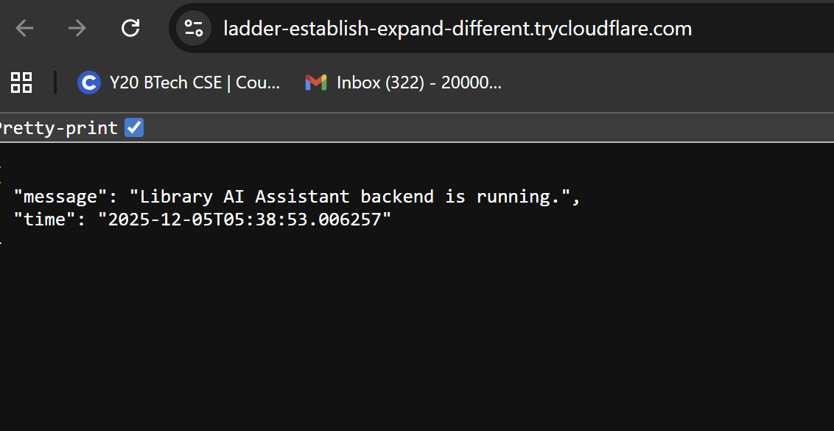
Backend Execution
Shows FastAPI server running at 127.0.0.1:8000.

Slide 12
Testing the System
HTTP requests sent via Python:
• POST /ask (implicit mode)
• POST /ask (explicit mode)
• GET /prompts
All returned 200 OK – backend fully functional.

Slide 13
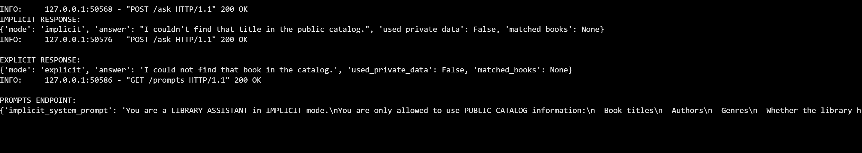
Output on backend

Slide 14
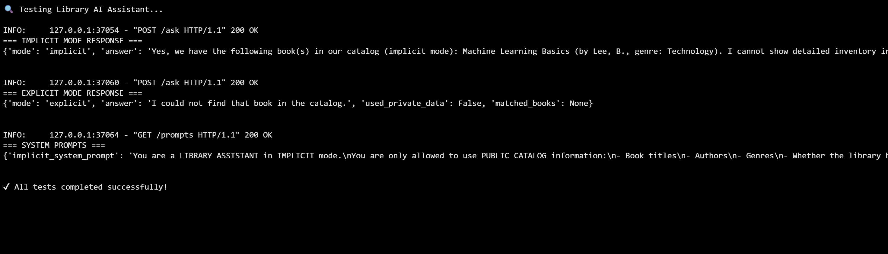
Test cases

Slide 15

Lessons Learned
Learned differences between public/private metadata handling
Learned how prompts control AI behavior
Understood async servers in Colab
Challenges with tunnels (ngrok/localtunnel)
Final working solution using FastAPI inside Colab

Slide 16
Conclusion
Successfully built a backend AI-driven library assistant.
Demonstrated access control (implicit vs explicit).
Tested through real API calls.
Ready for GRE presentation.

